Slide 1
West Midlands Regional Group
Chartership Application – Filling in the Forms
Notes:
Alex
Good afternoon and welcome to the 6th chartership self help group this year.

Slide 2
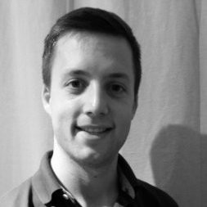
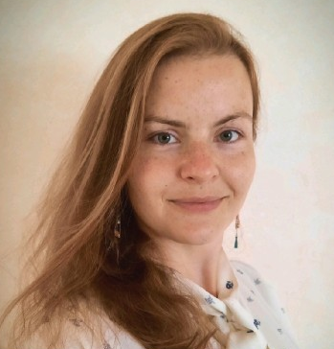
Introduction
Alex Deltenre - Atkins
Laura Westoby - Hydrock
Notes:
Alex
Laura is a Chartered Geologist who works at Hydrock as Geotechnical Engineer. Laura has an extensive range of experience in the engineering industry having worked for a GI contractor, various design consultancies which allowed her to supervise site works and undertake various geotechnical designs. Laura got chartered in June, having submitted her application in February.
I’m a Chartered Engineering Geologist at Atkins. Been with Atkins for 3 years, and previously worked in Mining and Mineral Exploration (hard to decide area of competence, but due to my CPD focussing on the civils side, my scrutineers wanted to opt for this – will make sense further down the presentation). Similar to Laura, I got chartered in June as well, but submitted my application back in December 2019. Covid led to some delays.

Slide 3
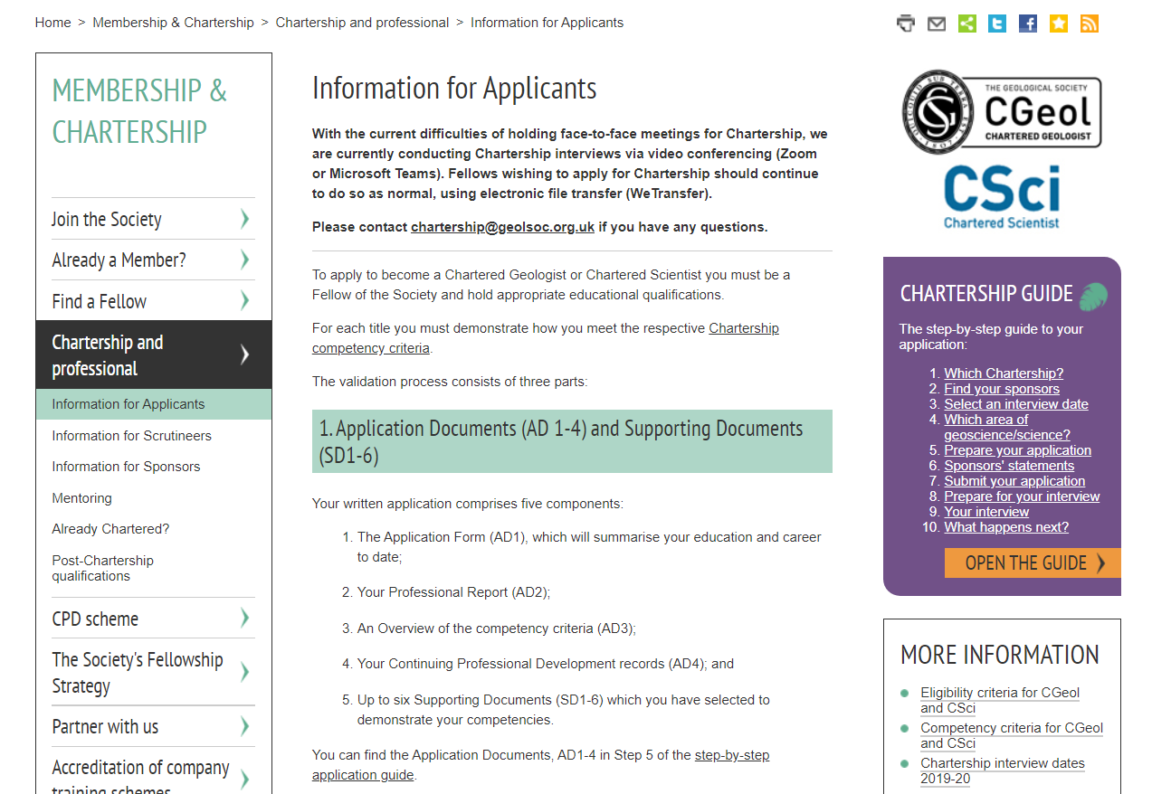
Where should you start?
Notes:
Laura
Alex and I recommend as a first port of call you have a look on the Geological Society’s chartership webpage in order to familiarise yourself with the application process. There are five components, including four application documents and your supporting documents.
If you click on step no. 5 in the purple box to the right then it takes you through to a webpage that has a detailed breakdown of all of the application documents. It’s on this page that you can also download the documents themselves, so you can familiarise yourself with what is required. It’s better to download them from the website rather than use a version provided by a sponsor or mentor as it means you will have the most recent document; it should the suffix ‘n’.

Slide 4
Where did we start?
AD1 – The application form
AD2 – Your professional report
AD3 – Overview of the competency criteria
AD4 – CPD records
SD1-6 – Your supporting documents
Notes:
Alex
Laura and I had a discussion prior to creating this presentation about what order to go through the documents, and we thought it would be most useful to go through them in the order that we tackled them in. So even though they’re numbered 1 to 4, we didn’t necessarily complete the application documents in that order. We both did it more like this…..

Slide 5
Where did we start?
AD4 – CPD records
SD1-6 – Your supporting documents
AD3 – Overview of the competency criteria
AD2 – Your professional report
AD1 – The application form
Notes:
Laura
So why this order you ask? Well, for one, all your CPD should already be up to date and therefore you shouldn’t really have anything to do for AD4 other than maintain it until you submit. So, that’s one done already. Most people leave it till the end and rush it. I would recommend you tart it up properly. Listen to Bill Gaskarth presentations, on youtube, as he will tell you that this is not a postage stamp collection. Make sure you set objectives and reflect. It is another easy win as it should be up to date (cough!).
I then found it easier to collate my supporting documents. My mentor and sponsors suggested that I save copies of documents or drawings I had completed, particularly when they were interesting, or showcased the best of my abilities, or were something unusual that didn’t follow a company template. This meant that I had a pool of information I could choose supporting documents from, ready for when I wanted to write my application. I would mention though that it is best to confirm with your employer that this is ok, that they’re happy for you to do this (although it shouldn’t be an issue as confidentiality is key throughout your application).
Some of the feedback I received following my interview was that my scrutineers would have preferred the supporting documents to have been showcased on a project by project basis, rather than categorised as I had by ‘ground models’ and ‘health and safety’, to name a couple of my supporting documents. It would always be worth having the discussion with your mentor or sponsors as to what the best approach is. If you have 6 SD, might be worth issuing 5 SD and keeping one for your presentation!
It might be worth, but not necessary to write a ½ page cover note for each SD and submit these to your mentor. When they were reading them, I focussed on the next parts, in order to not waste any valuable time.
Make sure your SD are in line with the competency you want to go for.

Slide 6
Where did we start?
AD4 – CPD records
SD1-6 – Your supporting documents
AD3 – Overview of the competency criteria
AD2 – Your professional report
AD1 – The application form
Notes:
Alex
The next thing we both tended to focus on was the competency criteria. In this document it is recommended that you refer to both your supporting documents and your CPD, so having these items complete by this stage is a great help. It saves any hassle later and means you don’t have to constantly update the document, as you have to cross reference your competency criteria with your supporting documents.
We both recommend that you read the buzz words in the preamble to each of the competencies (there are seven btw), because if you can tailor your answer to the question. This isn’t a document that requires an excessive amount of text, however it is a document that allows you to be personal and enables you to focus on your areas of expertise. This should only be a small paragraph – I believe the website says it should be 3-5 lines MAX.

Slide 7
Where did we start?
AD4 – CPD records
SD1-6 – Your supporting documents
AD3 – Overview of the competency criteria
AD2 – Your professional report
AD1 – The application form
Notes:
Laura
The next document that Alex and I recommend you tackle is the professional report. At this stage you’ve got all the documents in place that you need to refer to, so when the text starts flowing you can easily refer to a supporting document or application document to back up your skills. AD2, should be approximately 2000 words to tell who you are, what experience led to you gaining competence in specific critea and again direct scrutineers to SD. Alex’s report was 7 pages, which he was told was waaaaaaaaaaaay too long.
The professional report allows you to focus on your career progression, how you built your skill set and also allows you to show your passion for geology and how you want to encourage others to enjoy it as much as you. It’s where you showcase yourself. We’re not saying don’t read anyone else's professional report for an idea of what to include, but this report has to be from you. This is a document that should show your passion for the subject.
I think the best way I approached it was to break it down into sections. When writing, I tend to leave the beginning and end until I’ve written the bulk of the text (like you would a report at work), and then bullet what I want to include, whether that be projects I’ve worked on, career history or activities I’ve completed out of work that support my application. It’s always useful to get your sponsors or mentor to read it through; they’ll be able to proof read it for you, but may also point out skills or strengths that you’ve missed out. It’s also a good idea to tailor it to your current skill level; if you’ve helped more junior members of staff develop then include that, or if your focus is now more on management and business development, include those skills. The Chartership webpage specifically states that ‘It is particularly important that you describe how and when you gained the necessary experience and skills which you claim qualify you to become Chartered’.
At the end I made sure I included references in the text to the documents I had referred to, in order to back up the claims had made. It is also important that you get the professional report signed off by the relevant person; in my case this was made slightly more difficult because I was going back through a couple of different jobs. If you have a potted career history then it may be worthwhile getting in touch with some former colleagues when you start thinking about compiling your application, so they have some warning that they might be needed.

Slide 8
Where did we start?
AD4 – CPD records
SD1-6 – Your supporting documents
AD3 – Overview of the competency criteria
AD2 – Your professional report
AD1 – The application form
Notes:
Alex
AD1 is filling in your details, which you should know. This takes 30mins max and is such an easy win if you decide to do it first OR a nice way to finish off the application when your mentors are reviewing your submission.
I am not going to dwell on this too much, as it is pretty straight forward. You should know your education and career histories. It is worth showing progression during your career, so if you got promoted at the same company, put these roles and responsibilities down separately.
Also ensure you do not forgot to populate the List of Verifiers of your application and Supporting Documents. It is buried in some preamble but do not forgot it.
One thing to note, that withing AD1n, you no longer tick boxes of your competencies, but you have to write them down the area where you think your competency (or competencies lie). If you pick two, make sure your application is tailored to prove evidence for both.
Lastly, you should advice the location of your interview…..although with Covid I suspect they will be held on Zoom.

Slide 9
Discussion
4-7 months to compile entire application.
Once submitted, focus on interview and presentation
Be prepared to provide additional information.
Go for chartership when you are ready!
Has anyone done/ doing it differently?
What problems are you facing?
Any hints and tips?
Notes:
Alex
It took Laura and I about 4-7 months to finalise our application, from start to finish.
Do let your foot of the gas, start writing and preparing your presentation and interview. This is half the battle!
Do not feel dishearten if asked for more/ different SD. Take it as an opportunity so add extra rather than replace project work and valuable geological experience.
Go for chartership when you feel ready, not when your employer tells you to go for it! You don’t want to feel disheartened when the geolsoc feels you are not ready but you were pushed by your employer.
As we have time, shall we have a discussion;
- Has anyone done/ doing it differently?
- What problems are you facing?
- Any hints and tips that anyone would like to share with people that hasn’t started yet?

